Slide 1
National Training Project
Established to deliver nationally-recognised training
2011 Pathways training
Grants to sector RTOs, sector orgs and stations
Two grant rounds a year

Slide 2
Sector RTOs
BIMA
Radio Adelaide
Community Media Training Organisation (CMTO)

Slide 3
COMMUNITY
MEDIA
TRAINING
ORGANISATION

Slide 4
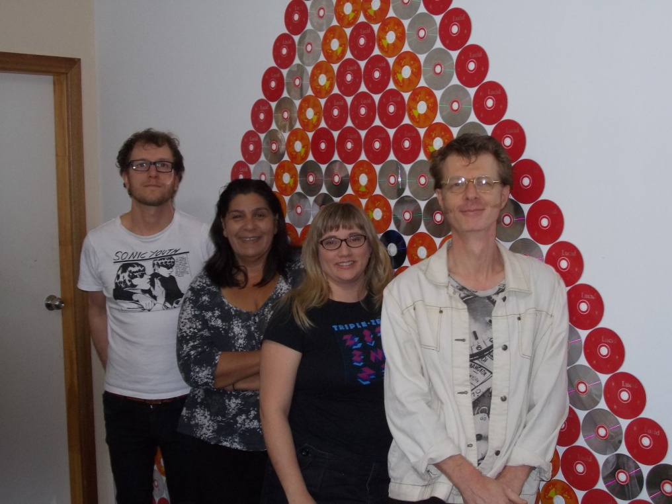
CMTO – YEAR 1- SNAPSHOT
RTO- January, 2011
CMTO Team established
Course delivery started in March
Sector Nominees to the Board appointed April

Slide 5
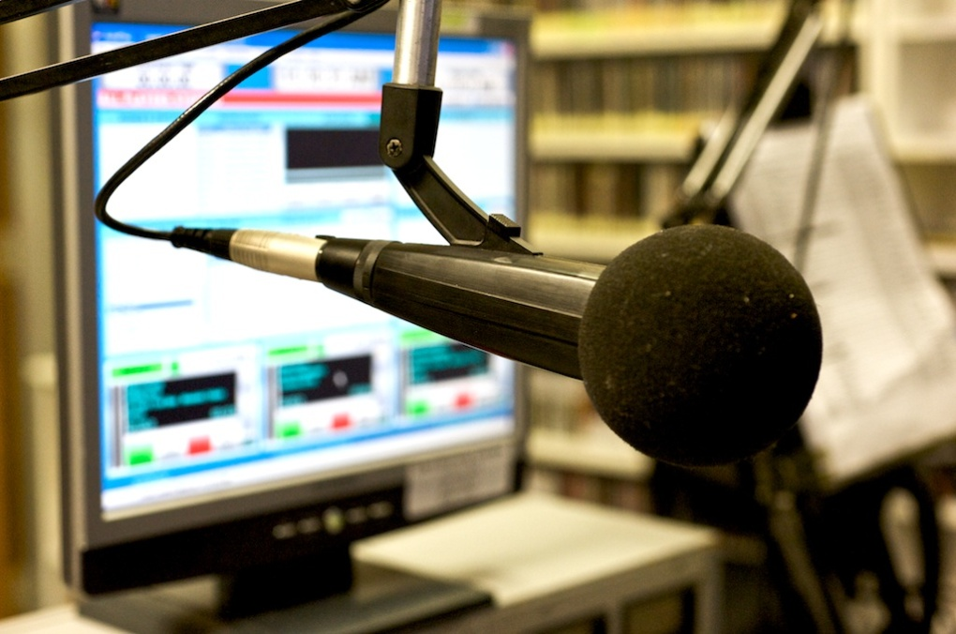
CMTO – YEAR 1- SNAPSHOT
9 x Certificate
41 x 1 day Pathways
About to start: 12 certificate courses & over 40 short courses

Slide 6
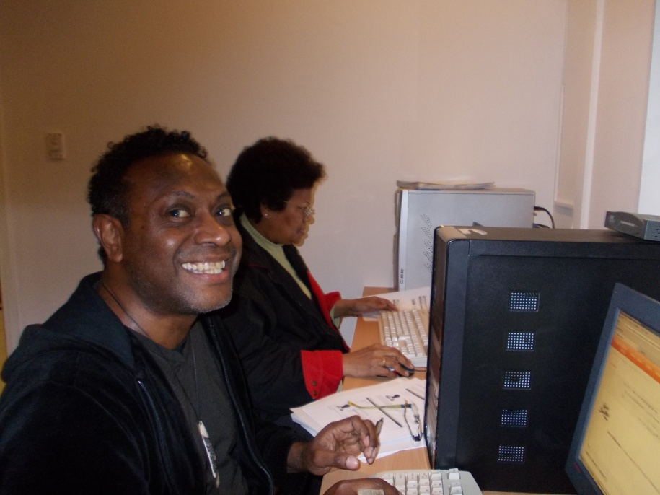
CMTO – YEAR 1- SNAPSHOT
240 students
27 trainers and coaches
35 stations

Slide 7
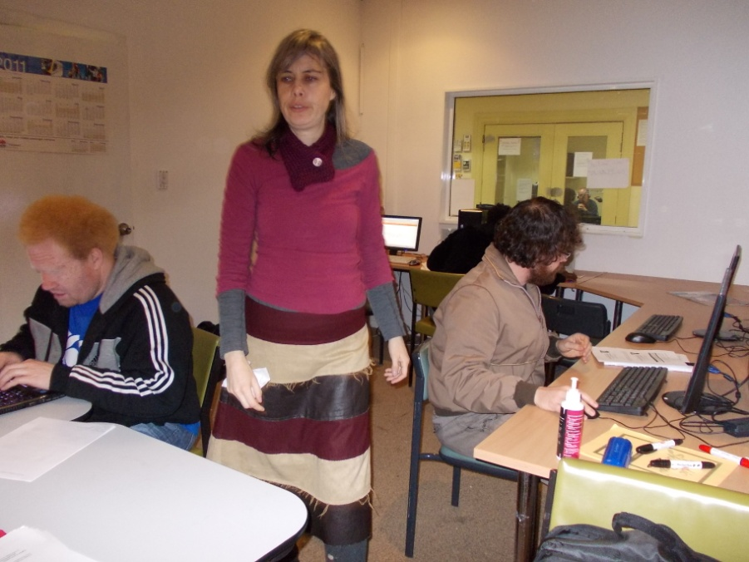
CMTO Pathways Courses

Slide 8
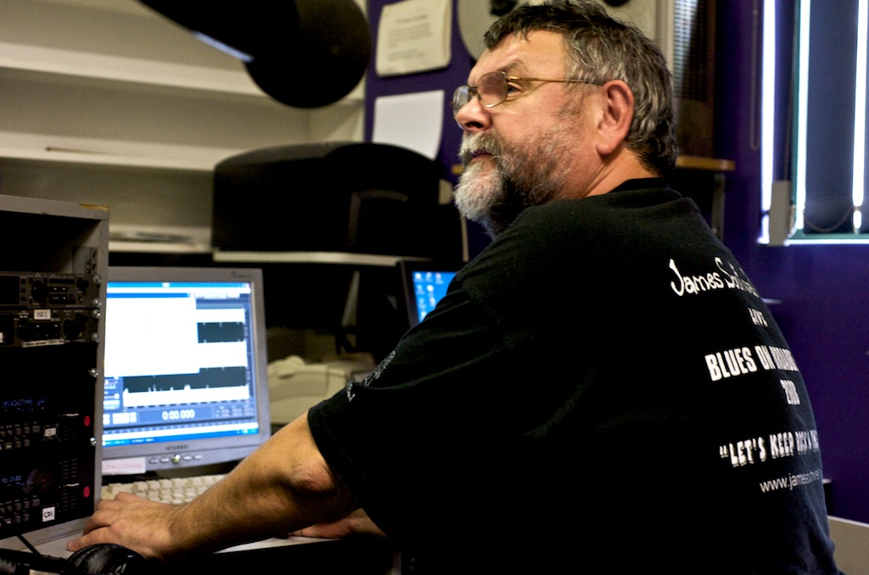
CMTO Certificate Courses

Slide 9
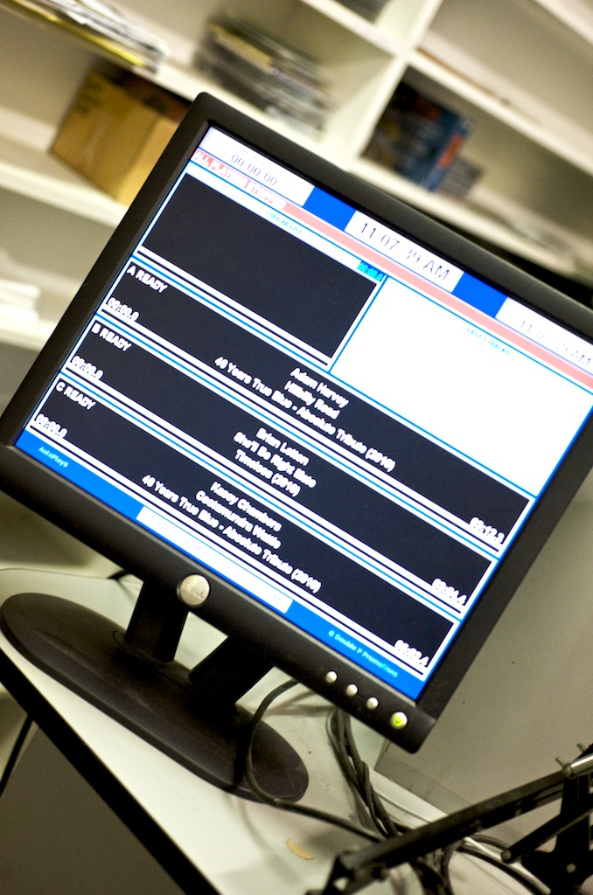
CMTO Online School
Training Videos
MOODLE
RPL Kits
OHS and Media Law

Slide 11
CMTO Online School
Live Classroom
Webinars
Discussion Groups
Interactive Training

Slide 13
fbi Become a Radio Pro
RPL
Mentors
Mentees

Slide 14
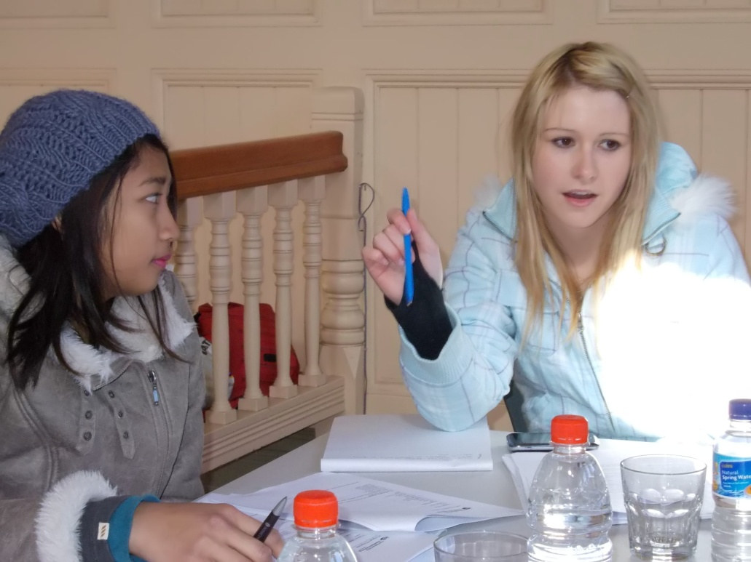
CBF Funding
Hassle free for stations
CMTO applies for the grant and therefore does the acquittal
Stations get paid a host fee

Slide 15
We Need Students for Trials
Online Students
Sign up for trials by putting your name on the list at the media lab
Email: info@cmto.org.au

Slide 16
Training Surveys
Surveys for:
Individuals
Stations
Media Lab

Slide 17
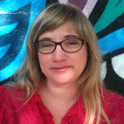
CMTO
Goodbye Bruno

